Slide 1

Atos|Syntel Batch: 13-Feb 2019
Trainer: Mahesh Rajput

Slide 2
Presented by:
Josh Ceciliani, Ryan Clayton,
Yosuf Elsaadany, Jason Viator

Slide 3


Points to Cover
Problem Statement
Overview
Team Introduction
TRM Architecture
Tools
Process

Slide 4
Points to Cover Cont.
Live Demo
Challenges Faced
Learning
Future Enhancements

Slide 5
Problem Statement
Why do we need TRM?
Automating life cycle of training requests
Efficiency of scheduling
Same vertical communication
BNFS, INS, MFG, RLT, HC
Centralized location for data
Ease of SPOC labor

Slide 6
Overview
Y/N
PM
SPOC
Project Manager requests training
1 SPOC per vertical
SPOC receives request
IT
DT
VT
SPOC chooses path for request
SPOC manages required details
1) Schd.
2) Date
3) Appr.
1) Schd.
2) Trnr.
3) Appr.
1) List
2) List
3) Appr.
SPOC requests PM approval
Exec
Project Manager confirm or reject

Slide 7
Team Introduction
Notes:
Point out people in particular teams that went above and beyond.

Slide 8
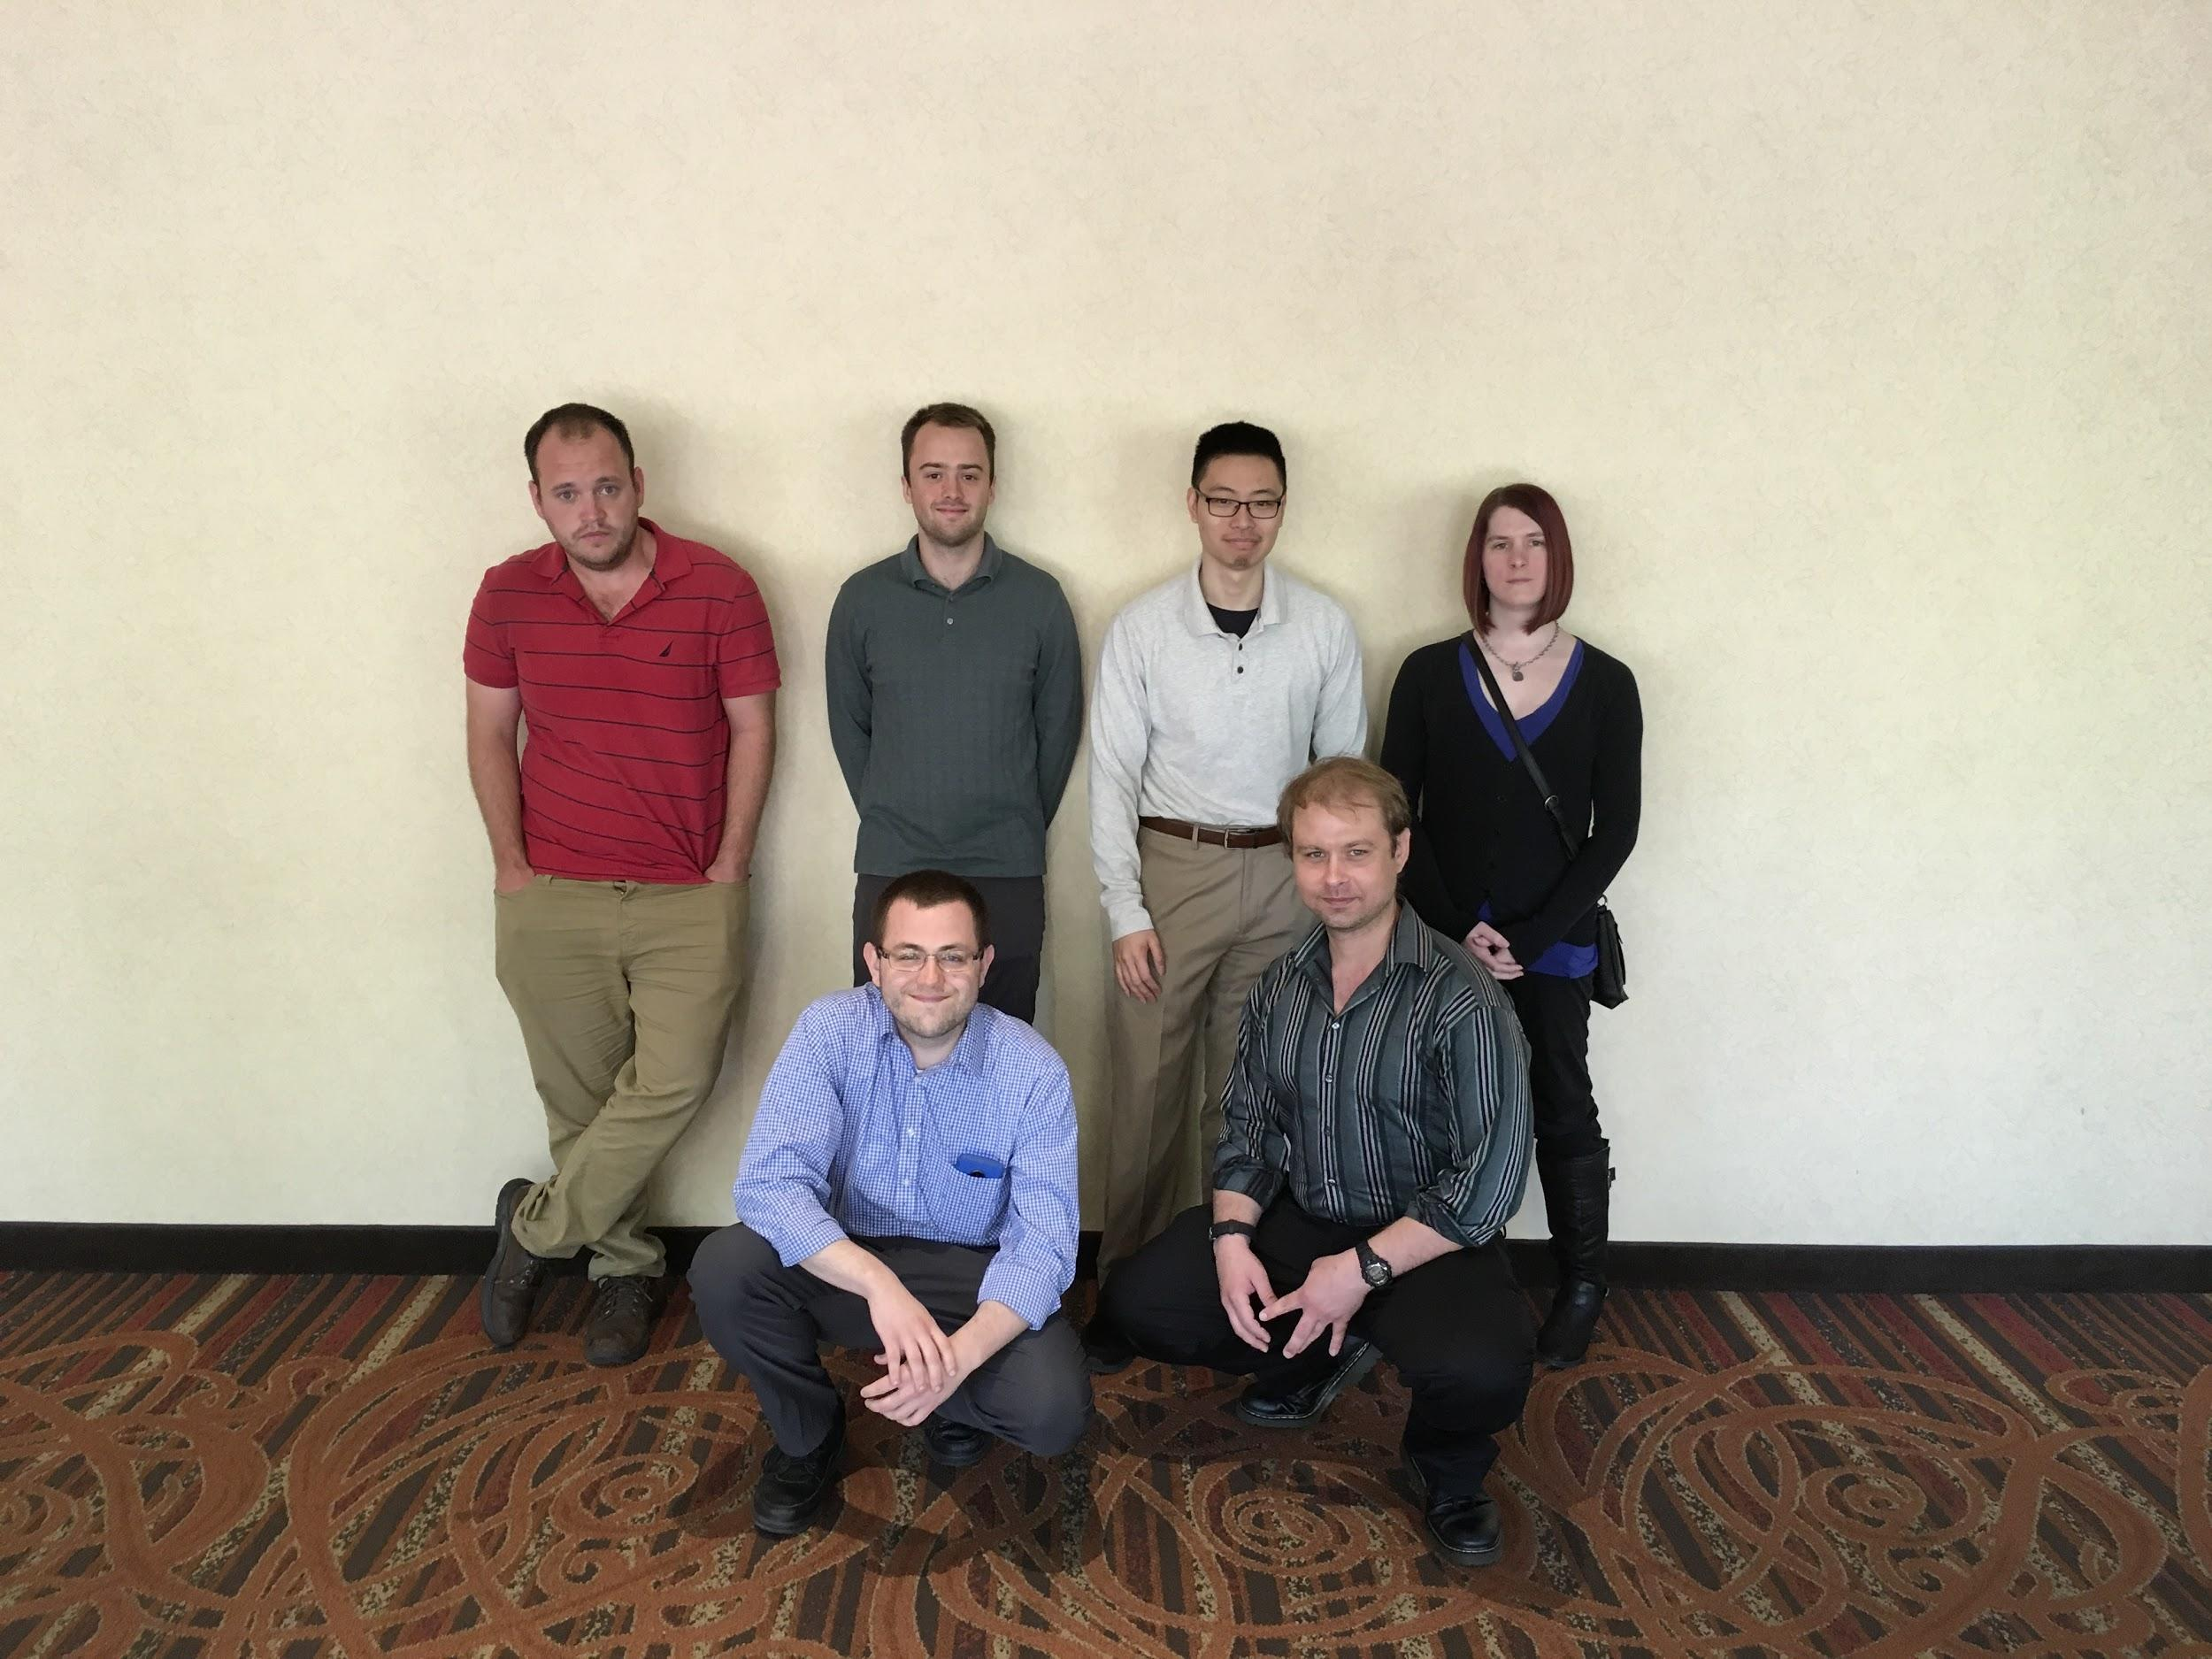
Project Manager Team
From Left to Right:
Mike Barnett
Phil Hansen
Ryan Clayton
Nathan Sun
Scott Sievers
Joanna VanBrunt

Slide 9
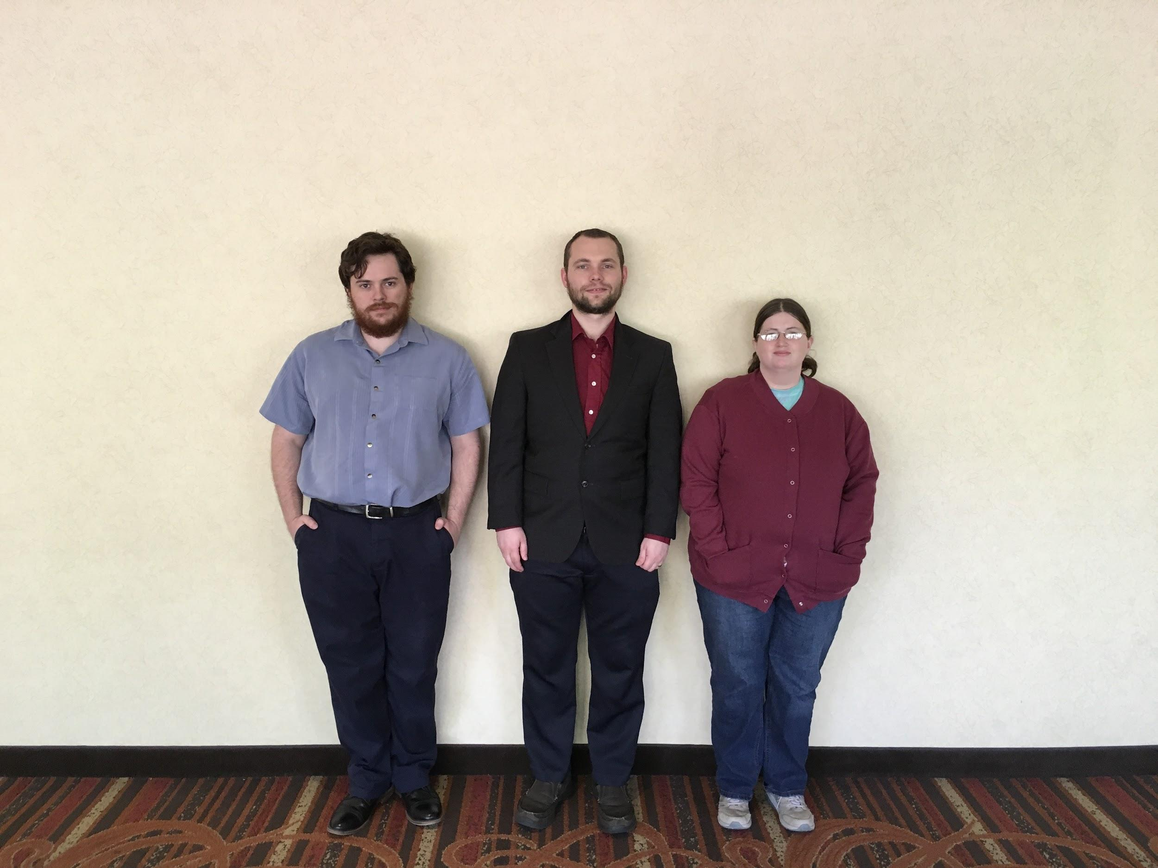
Internal Training Team
From Left to Right:
Quinn Pepper
Charles Chatwin
Denise Perry

Slide 10
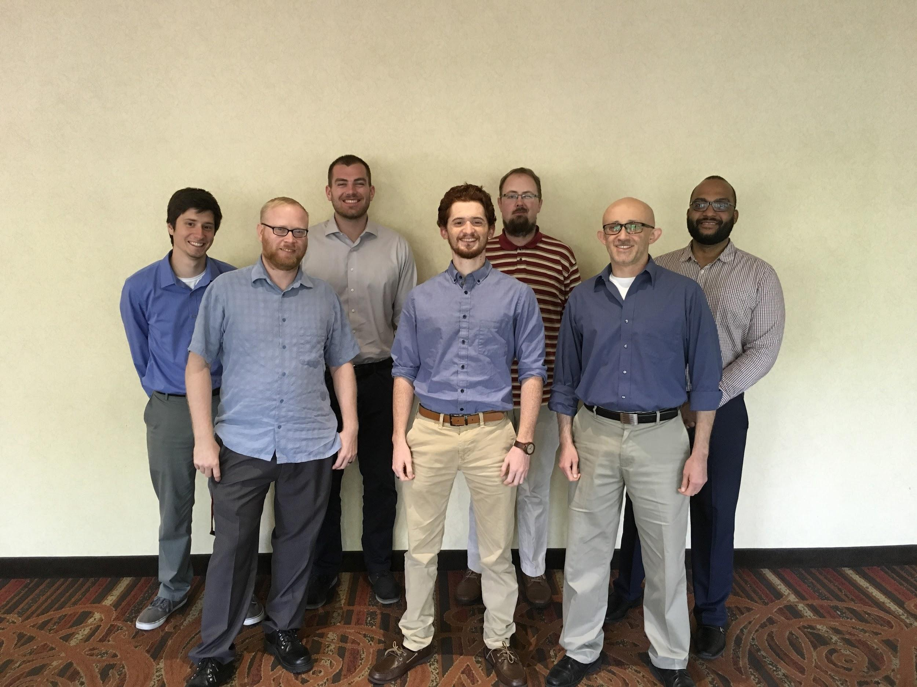
Develop Training Team
From Left to Right:
Matt Davino
Jason Viator
Alex Schlee
Patrick Strader
Lance Wessale
Jesus Ramirez
Pablo De La Cruz

Slide 11
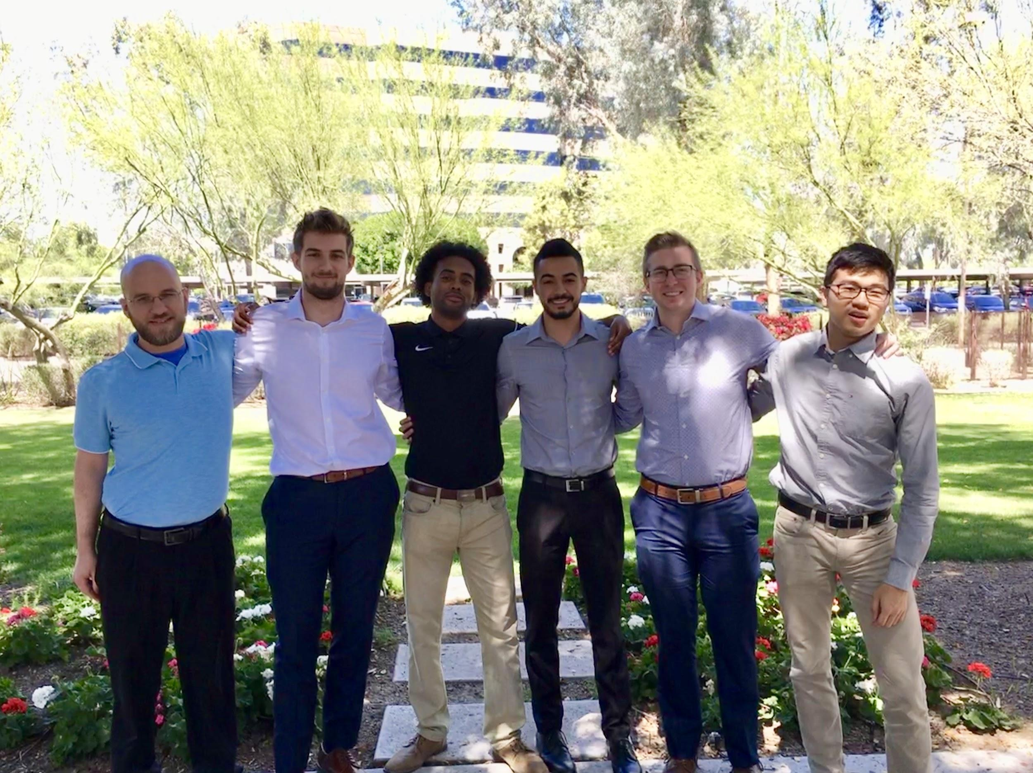
Vendor Training Team
From Left to Right:
Ryan Swanson
Nic Mori
Jabril Muhammad
Yosuf Elsaadany
Josh Ceciliani
Yubin Li

Slide 12




TRM Architecture
Tablet
Apache Tomcat Server
Oracle Database
Services
Phone
Spring MVC
DAO
Desktop
Internet
Notes:
Jason Start

Slide 13


















Tools
Notes:
Add Agile Logo and Kanban logo on 4th click
Make arrows smaller -> Point directly at logo

Slide 14
Process
Mock-Agile
Scrum stand ups
Sprint planning
Pair Programming
Kanban boards

Slide 15

Live Demo
Notes:
Set an expectation in advance, before demo.
Yosuf Start

Slide 16
Overview
Y/N
PM
SPOC
Project Manager requests training
1 SPOC per vertical
SPOC receives request
IT
DT
VT
SPOC chooses path for request
SPOC manages required details
1) Schd.
2) Date
3) Appr.
1) Schd.
2) Trnr.
3) Appr.
1) List
2) List
3) Appr.
SPOC requests PM approval
Exec
Project Manager confirm or reject

Slide 17
Challenges Faced
Timeline
Integration
Pkg#: 63 - Class#: 189
Communication
Team Decomposition
Changing Requirements
Debugging
Notes:
Ryan Start

Slide 18
Learning
Learn - Implement - Develop
Agile/Scrum/Kanban
Team Collaboration
Time Management
Integration
Client Interaction

Slide 19
Future Enhancements
Implement Angular or React
Validation
Testing
Executive screen

Slide 20

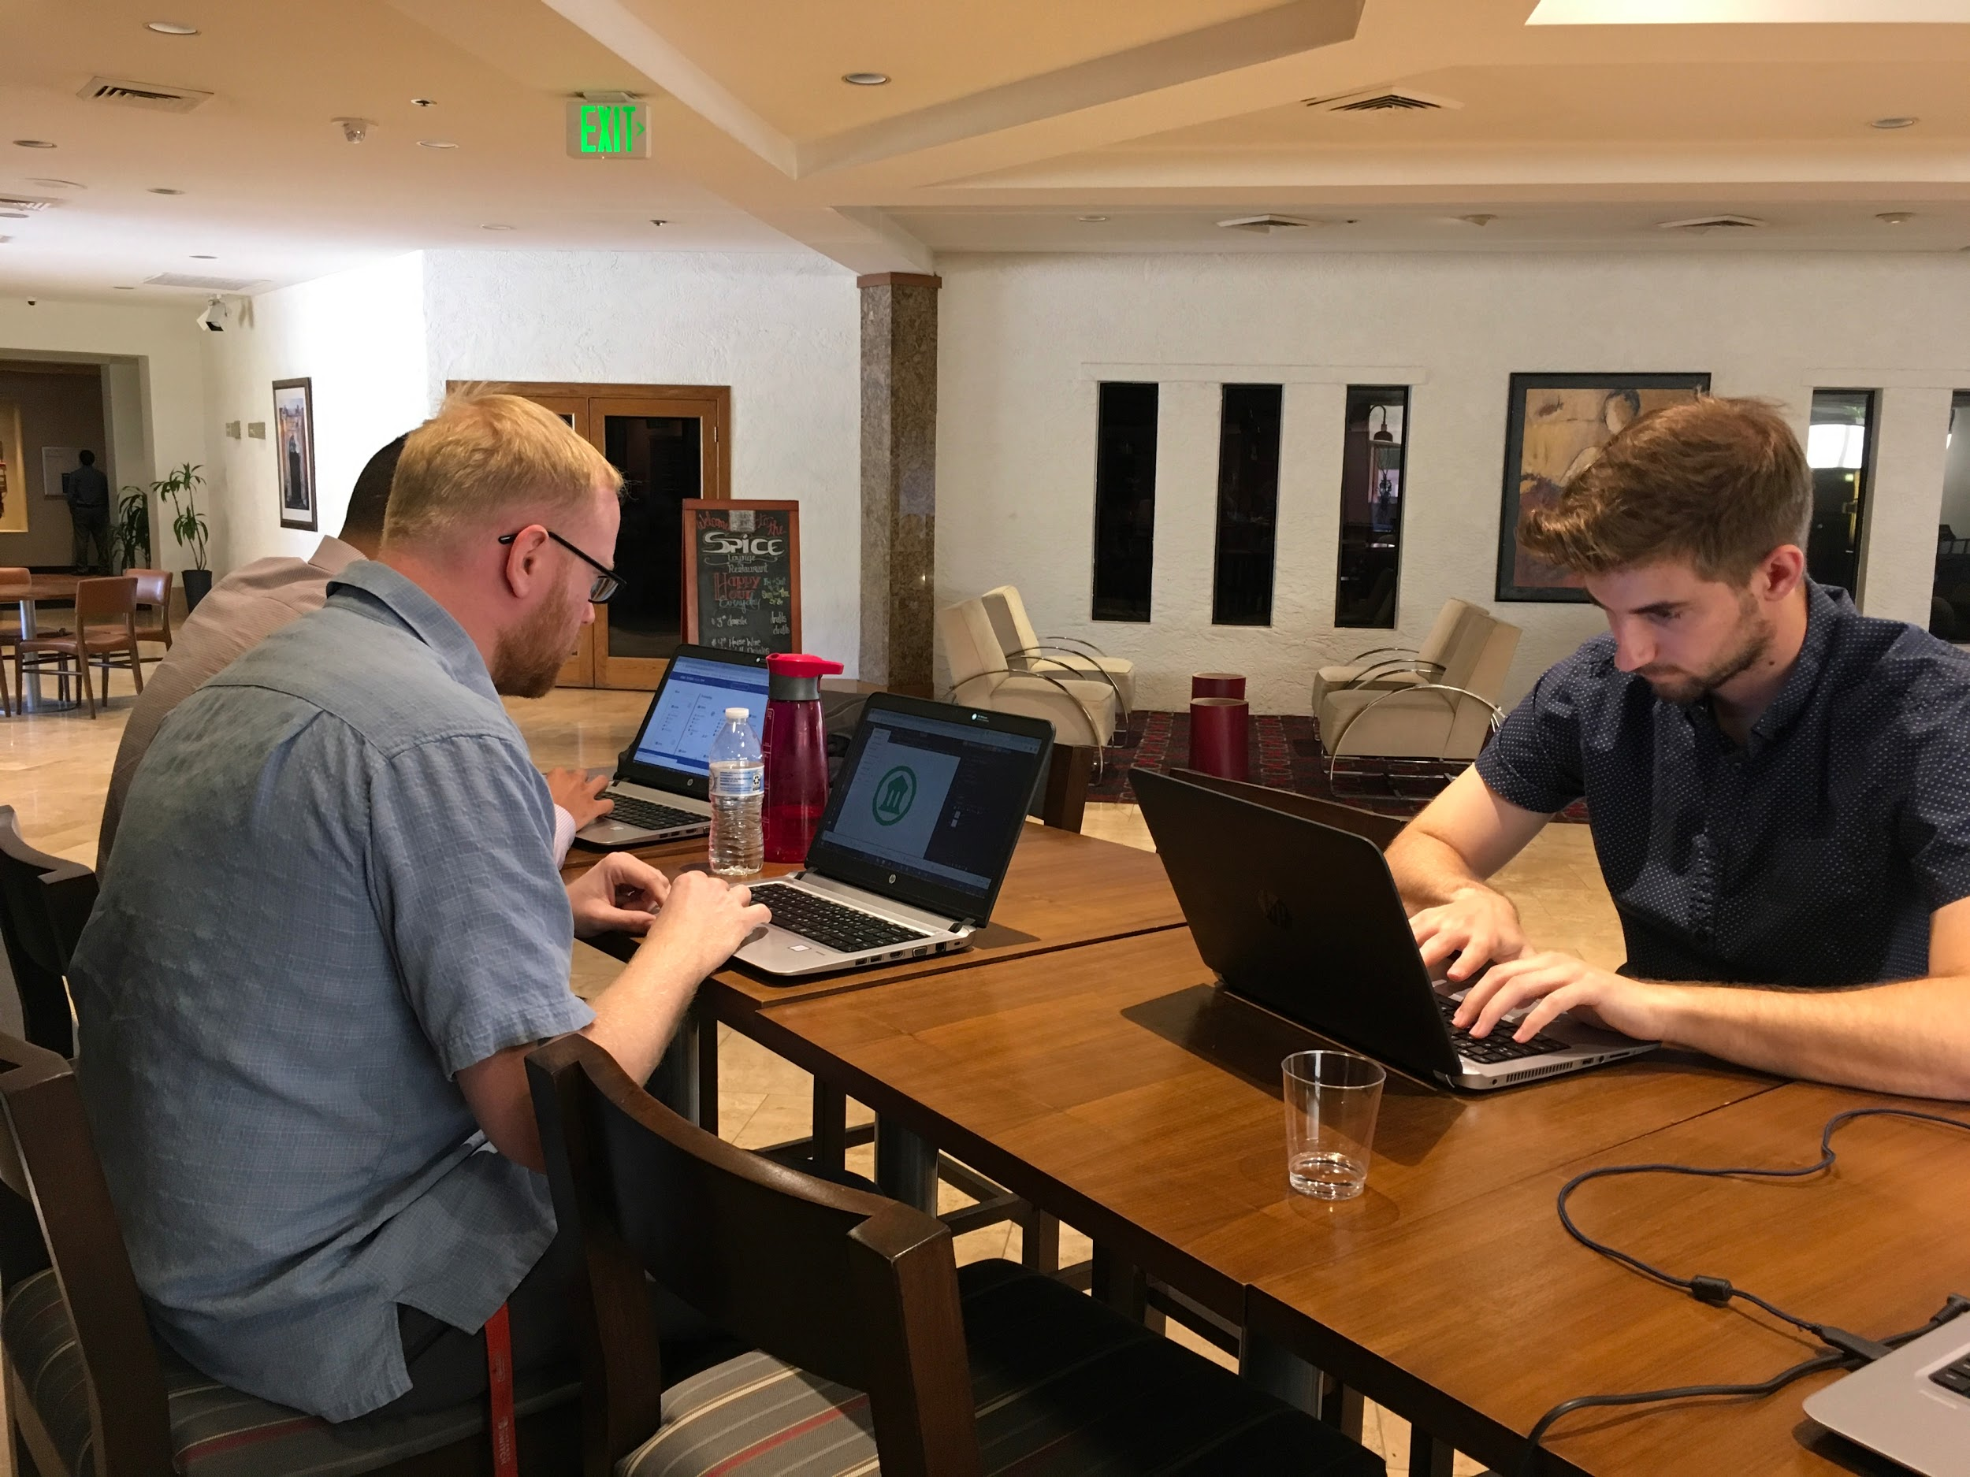
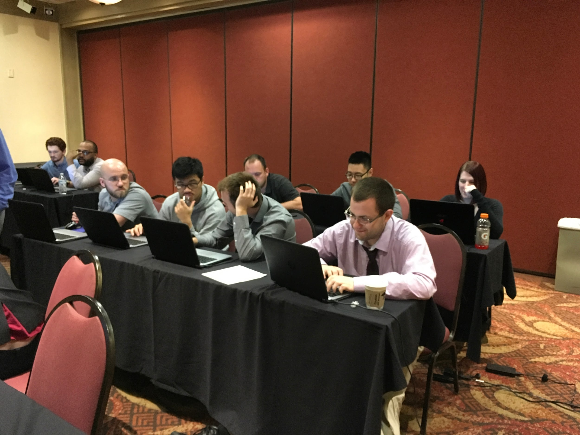
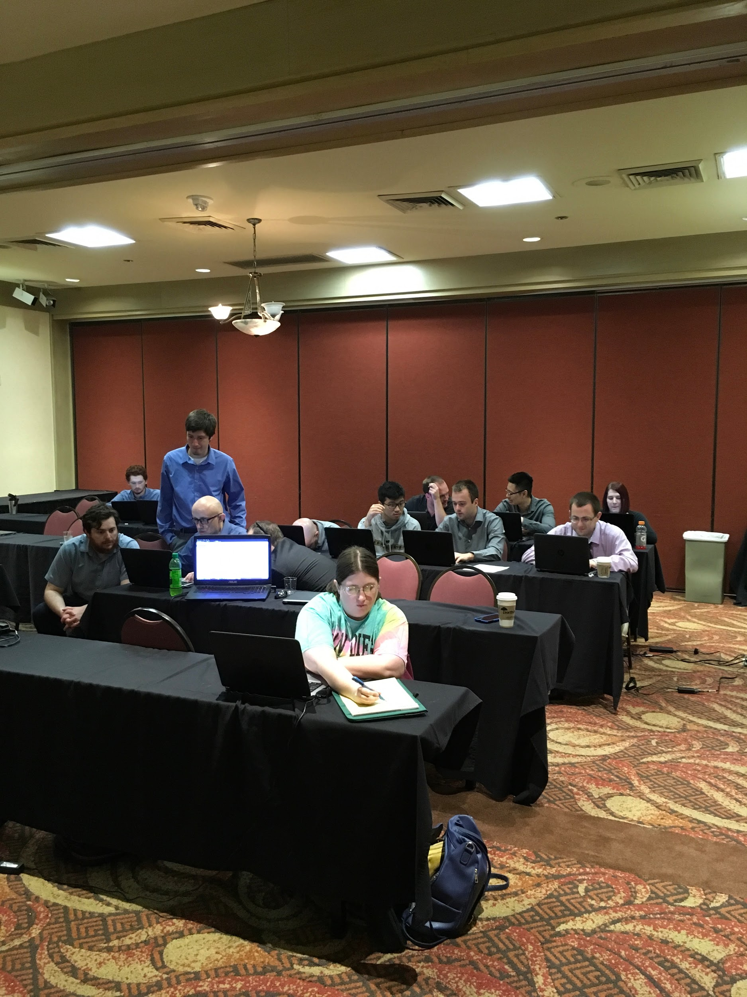

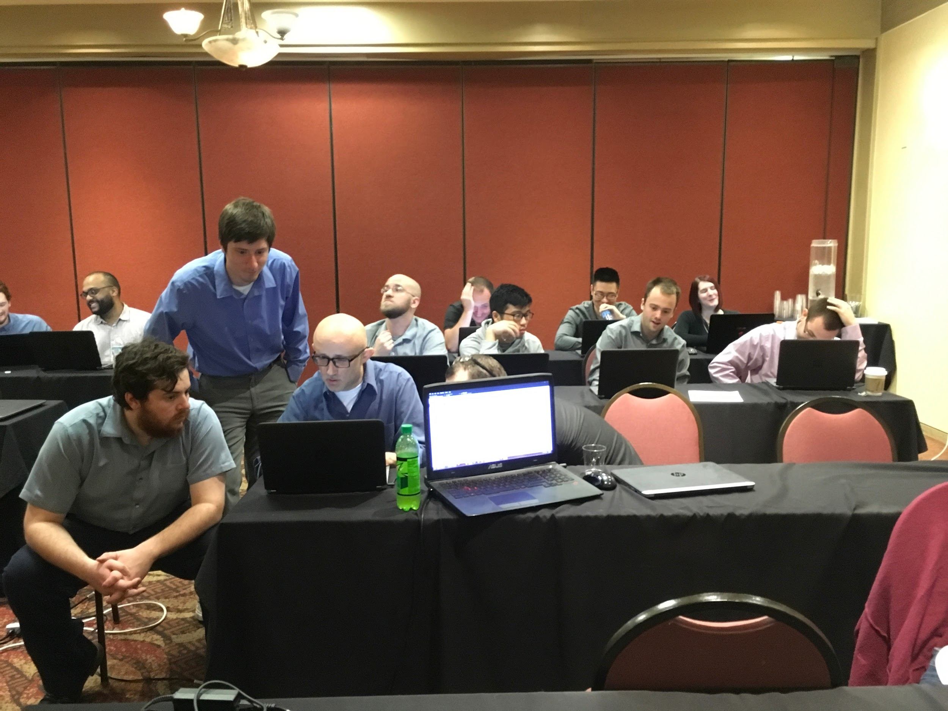
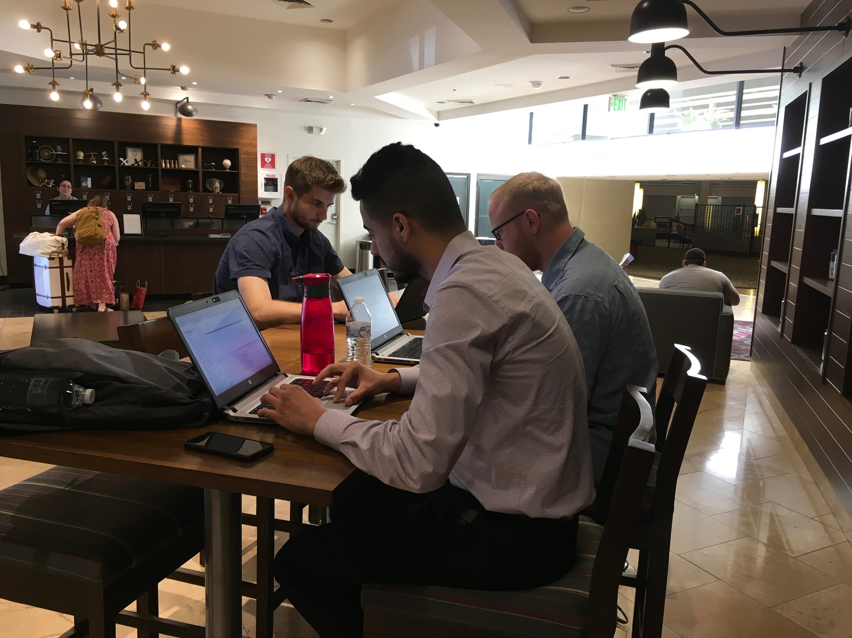
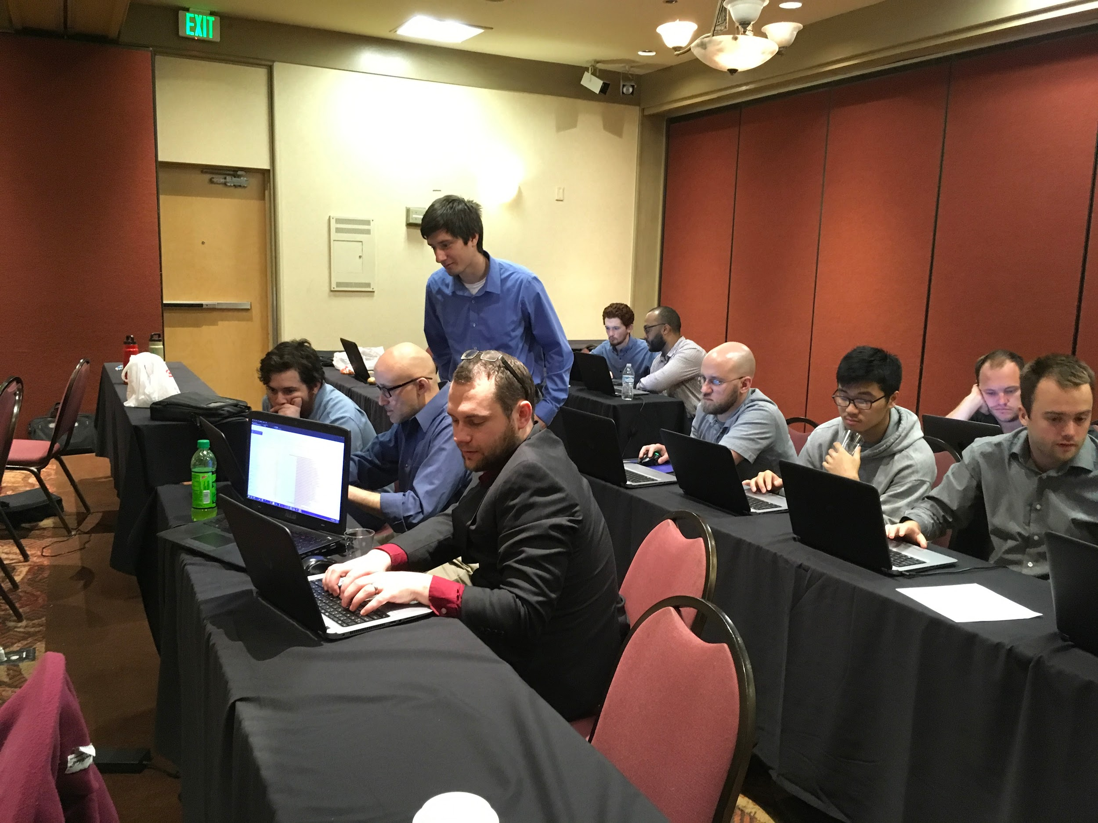
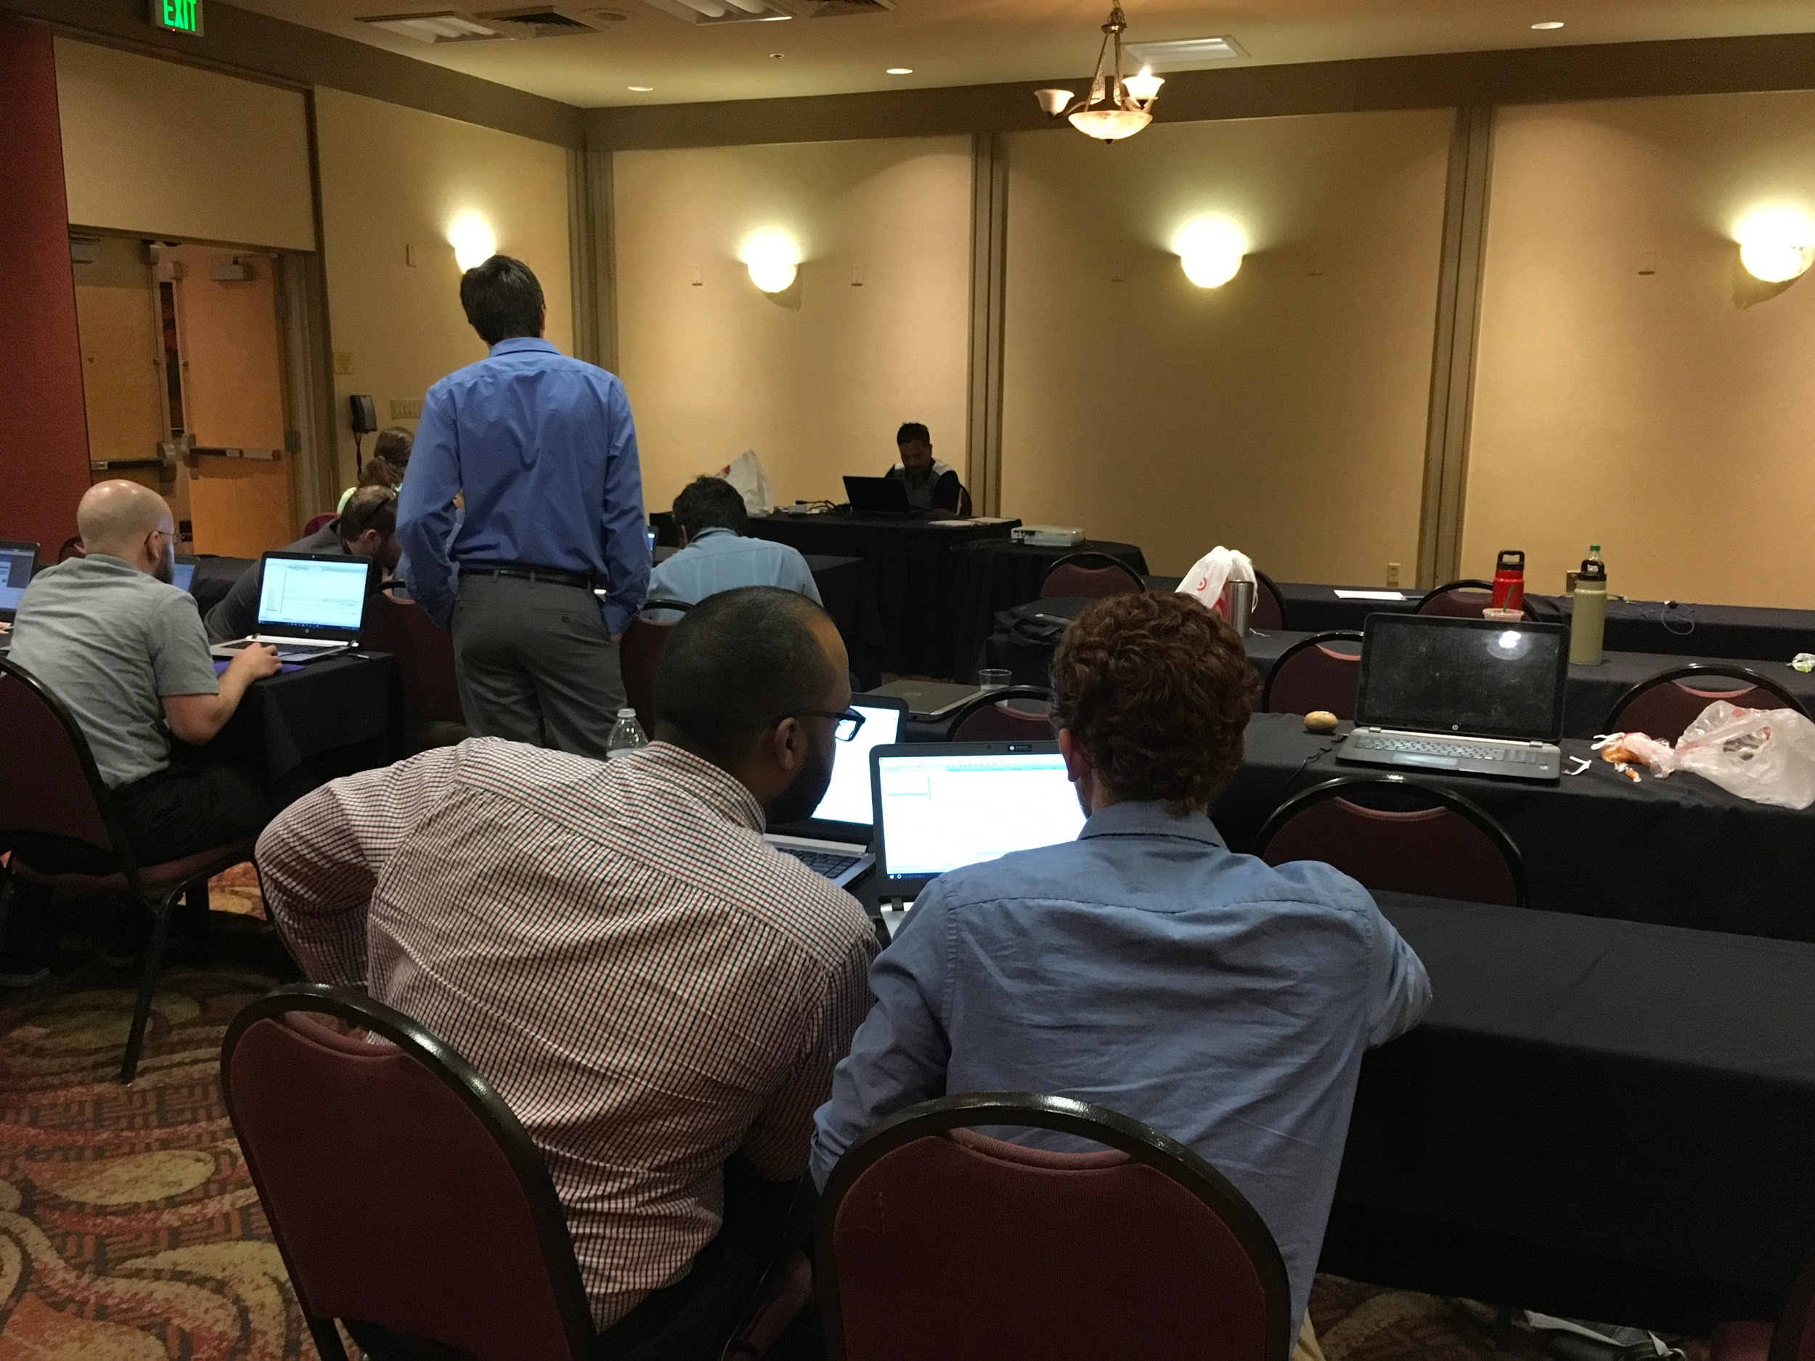

Slide 21
Q&A

Slide 22
Thank You
Notes:
Thank all managers for allowing this training to happen

